Slide 1
JS Syntax & Variables
JS background | Variables | Data Types | Comments and Semicolons | Input and Output
Notes:
Welcome to our lecture on JavaScript syntax and variables. In this lecture we will go through javaScript background, variables, data types, comments and semicolons, input and output. Let’s start our lecture.

Slide 2
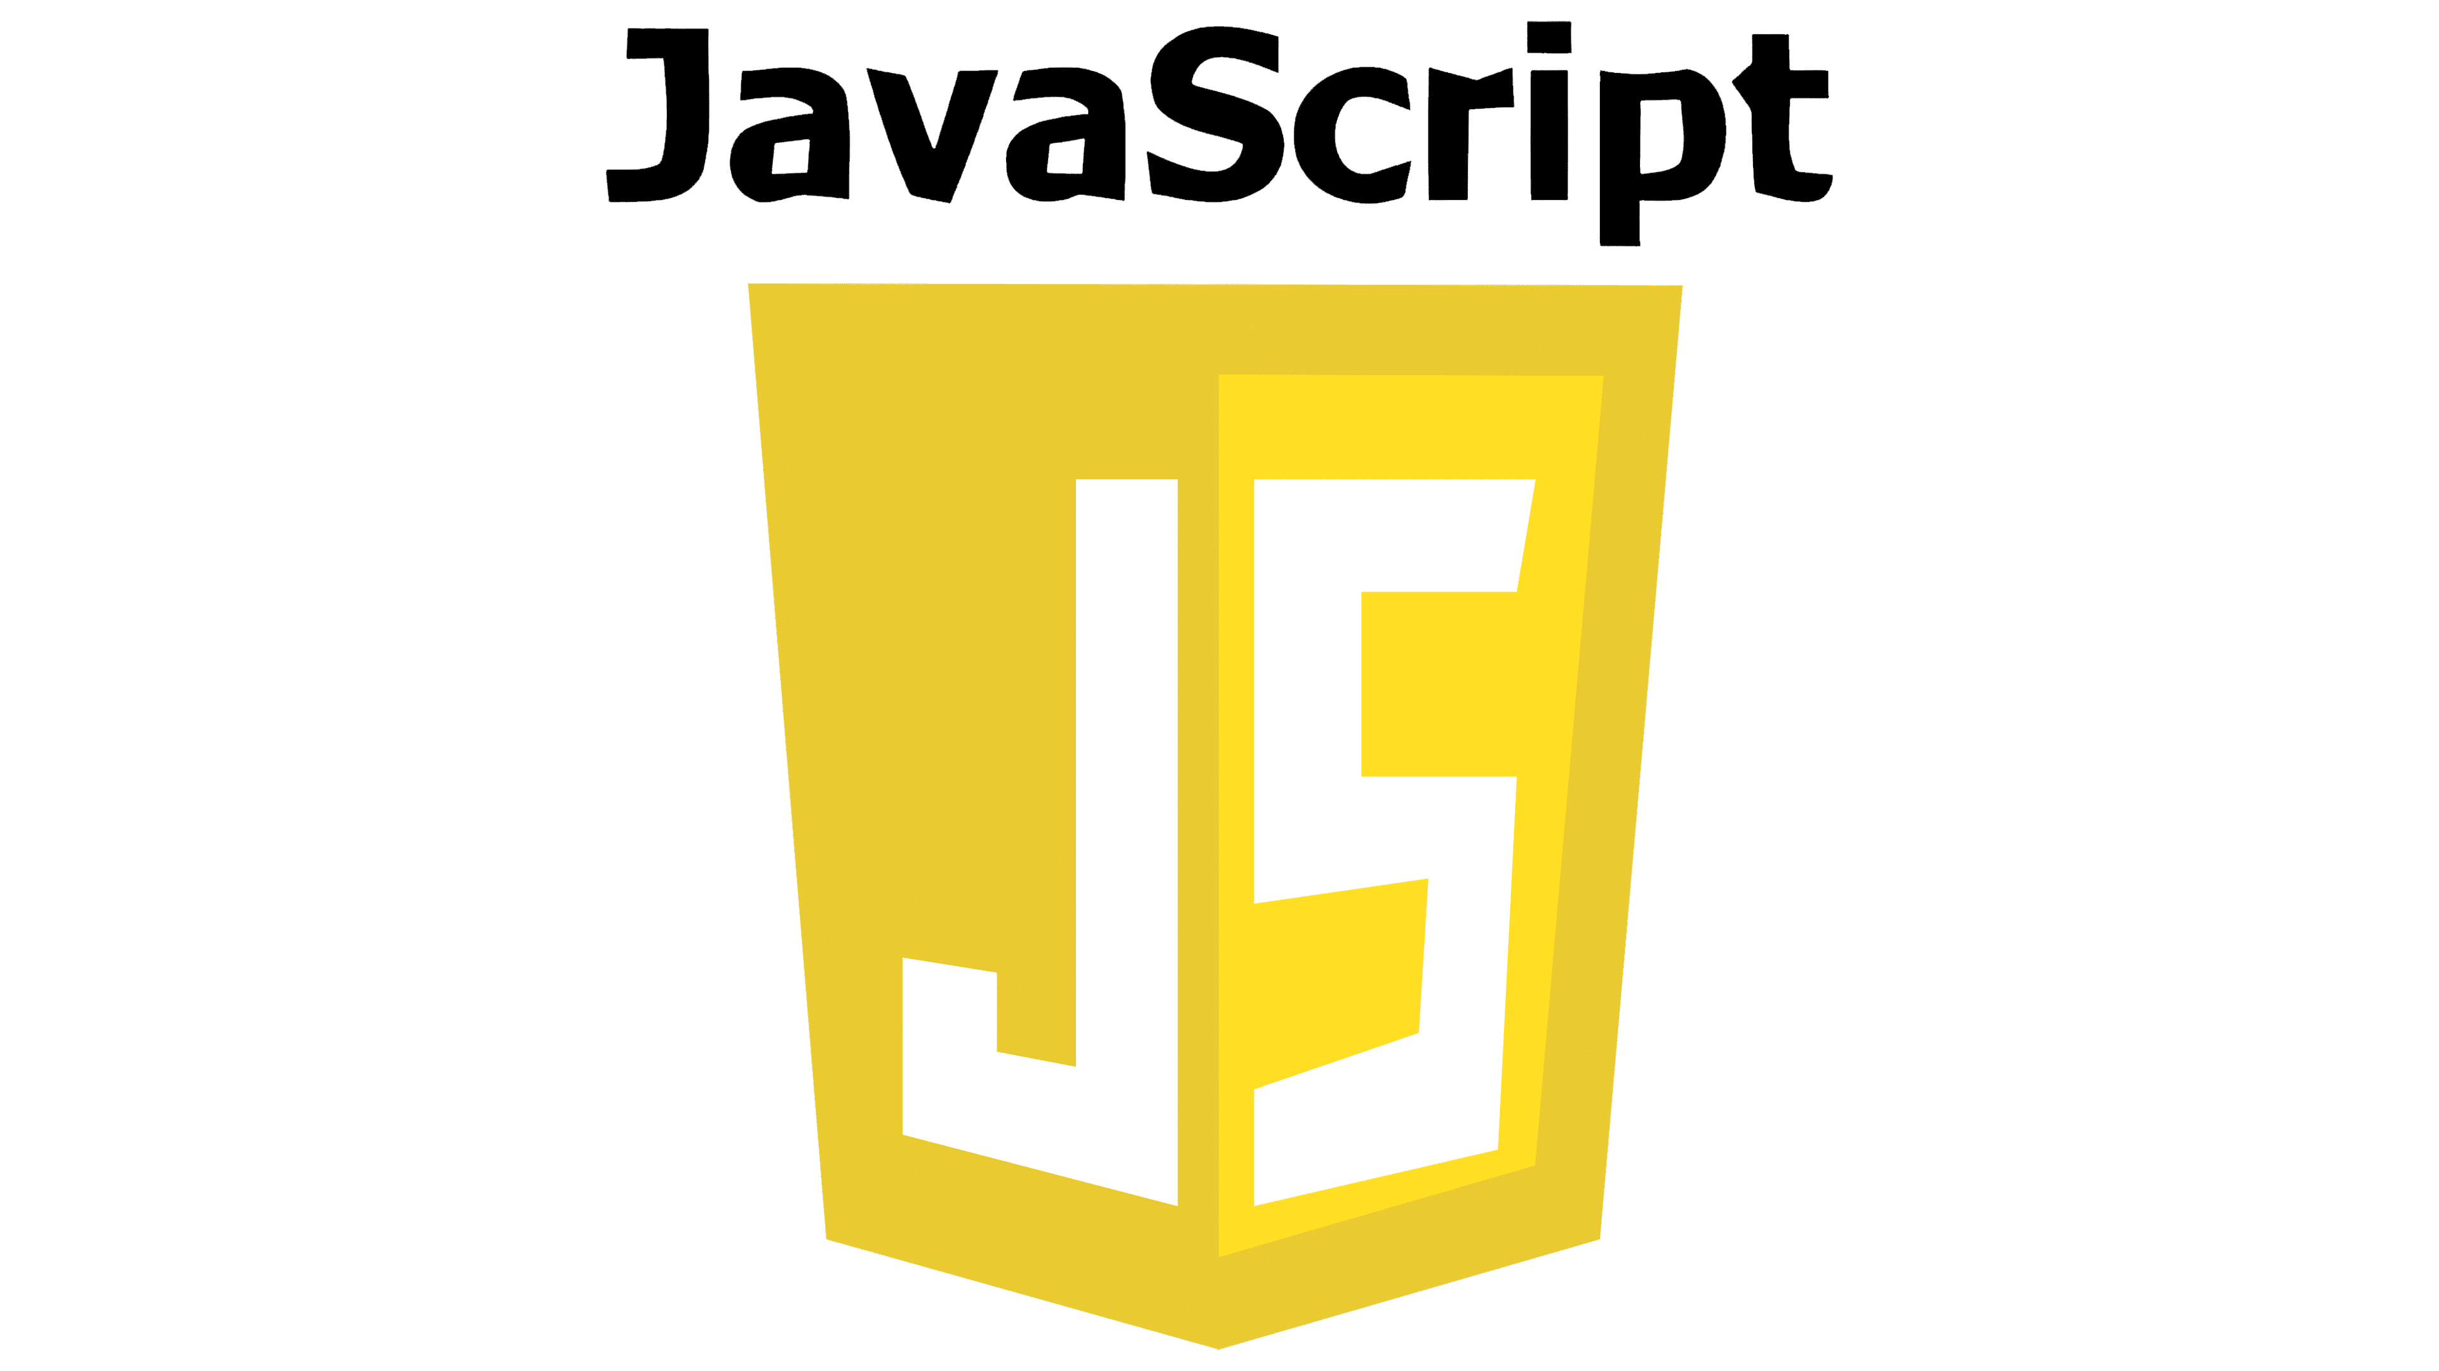
Background
Created in 1995: By Brendan Eich for dynamic web interactions.
Standardized: As ECMAScript in 1997, with yearly updates.
Wide Adoption: Used in browsers, web apps, and server-side (e.g., Node.js).
Fast Execution: Runs with JIT compilation for speed.
Notes:
JavaScript, created in 1995 by Brendan Eich, enables dynamic web interactions. It was standardized as ECMAScript in 1997, with yearly updates to improve the language. JavaScript is widely used in browsers, web applications, and server-side environments like Node.js. It runs efficiently using just-in-time (JIT) compilation, ensuring fast execution and high performance across platforms.

Slide 3
Variables
Variable Declaration: Declares a variable with let followed by the name (e.g., let score).
Assignment & Initialization: Assign values later (e.g., score = 2) or during declaration (e.g., let maxValue = 5).
Best Practice: Always declare a variable before assigning a value.
Notes:
Now let’s discuss variables. In JavaScript, variables are declared using the let keyword followed by the variable name, like let score. Values can be assigned later, such as score equal to 2, or during declaration, known as initialization, like let max Value equal to 5. Best practice is to always declare variables before assigning values to maintain clarity and avoid potential errors in the code.

Slide 4
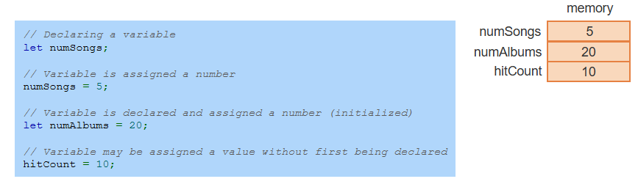
Variables Example
Notes:
This example demonstrates variable usage in JavaScript. A variable can be declared using let, like let num Songs. Values can be assigned later like num Songs equal to 5 or during declaration, known as initialization like let num Albums equal to 20. While variables can be assigned without declaration like hit Count equal to 10, it is best practice to always declare them to avoid issues.

Slide 5
Identifiers and Constants
Identifier Rules: Names can include letters, digits, underscores, or $, but cannot start with a digit or be a reserved word.
Camel Casing: Use camelCase for variables, starting with lowercase and capitalizing subsequent words (e.g., lastPrice).
Constants: Declared with const, constants are initialized variables that cannot change.
Best Practice: Always declare variables before assigning values.
Notes:
Identifiers in JavaScript are names for variables, constants, or functions. They can include letters, digits, underscores, and dollar sign, but cannot start with a digit or be a reserved word. Variables typically use camel Case, starting lowercase and capitalizing subsequent words like last Price. Constants are declared with const and cannot change. Always declare variables before assigning values for clarity.

Slide 6
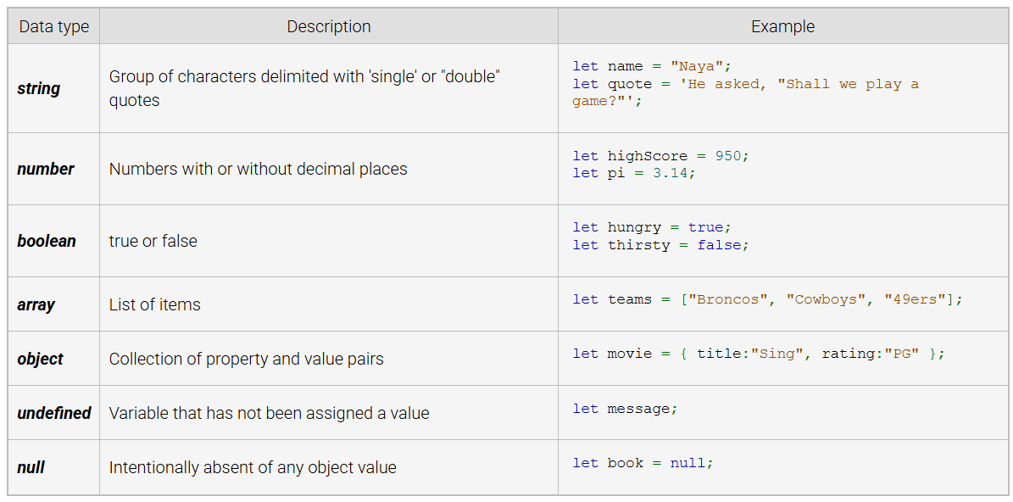
Common Data Types
Notes:
JavaScript supports various data types. Strings represent text in quotes, numbers include integers and decimals, and booleans store true or false values. Arrays hold lists of items, while objects are collections of key value pairs. Undefined indicates a variable without a value, and null represents an intentional absence of value. These types are essential for handling and organizing data in programs.

Slide 7
Comments and Semicolons
Comments: Use // for single-line and /* */ for multi-line comments; ignored by the interpreter.
Semicolons: Not required unless two statements are on the same line; good practice is to avoid this.
Consistency: Use semicolons consistently throughout the code, whether you include them or not.
Notes:
In JavaScript, comments are ignored by the interpreter. Use double back slash for single line comments and forward slash asterisk and asterisk back slash for multi line comments. Semicolons are not mandatory unless two statements are on the same line. Whether you choose to use semicolons or not, maintain consistency throughout your code for better readability.

Slide 8
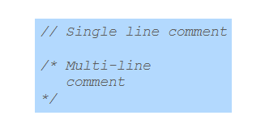
Comments Example
Notes:
In JavaScript, comments are used to leave notes or explanations for developers. Single line comments start with two forward slashes and are used for short notes, like forward slash forward slash Single line comment. Multi-line comments begin with forward slash asterisk and end with asterisk forward slash. These comments span multiple lines and are ignored by the interpreter.

Slide 9
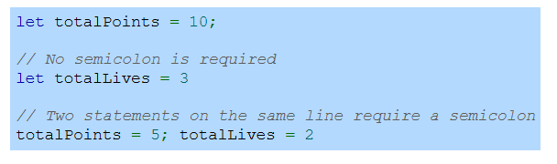
Semicolon Example
Notes:
In JavaScript, semicolons are optional at the end of a statement unless multiple statements are placed on the same line. For example, let total Points equals 10 semicolon ends with a semicolon, while let total Lives equals 3 does not require one. However, for total Points equals 5 semicolon total Lives equals 2, semicolons are necessary to separate the two statements on the same line.

